Slide 1
Tech Sharing - Aug 2022
Contract Testing
Pact & Spring Cloud Contract
By: Joseph Gan

Slide 2
Agenda
Objective
Goal
3W - What, Why, When
Consumer Driven Contract (Pact) w/ Demo
Producer Driven Contract (Spring Cloud Contract) w/ Demo
Comparison
Q&A
Notes:
Go through 3W
Go through Consumer and Producer Driven Contract Testing
Go through Pact and SCC Demo

Slide 3
Objective (of this sharing)
Introduce Contract Testing
Understand the differences between CD and PD
(Maybe) Deciding if we want to use it

Slide 4
Goal (of Contract Testing)
Allow individual system to test independently of others
Notes:
In turn; reduce coupling, reduce/eliminate breaking change

Slide 5
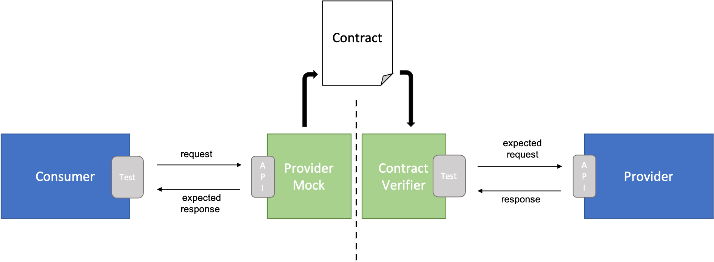
Terminology
Contract
A document that defines the expected request, response, header, body, etc. that is agreed between the teams
Endpoint, Input, Output
Consumer
System that consumer the API from the Provider
Provider
System that provides the API to the Consumers
Source: Microsoft

Slide 6
What is Contract Testing?
A type of testing methodology which ensures the provider meets the expectation of consumer when test in isolation through “contracts”
A contract is an agreement set between provider and consumer how communicate should be
Test against HTTP or Messaging protocols
Consumer generally come up with the API they really needs for provider to fulfill
Teams still need to talk to each other before coming up with contracts

Slide 7
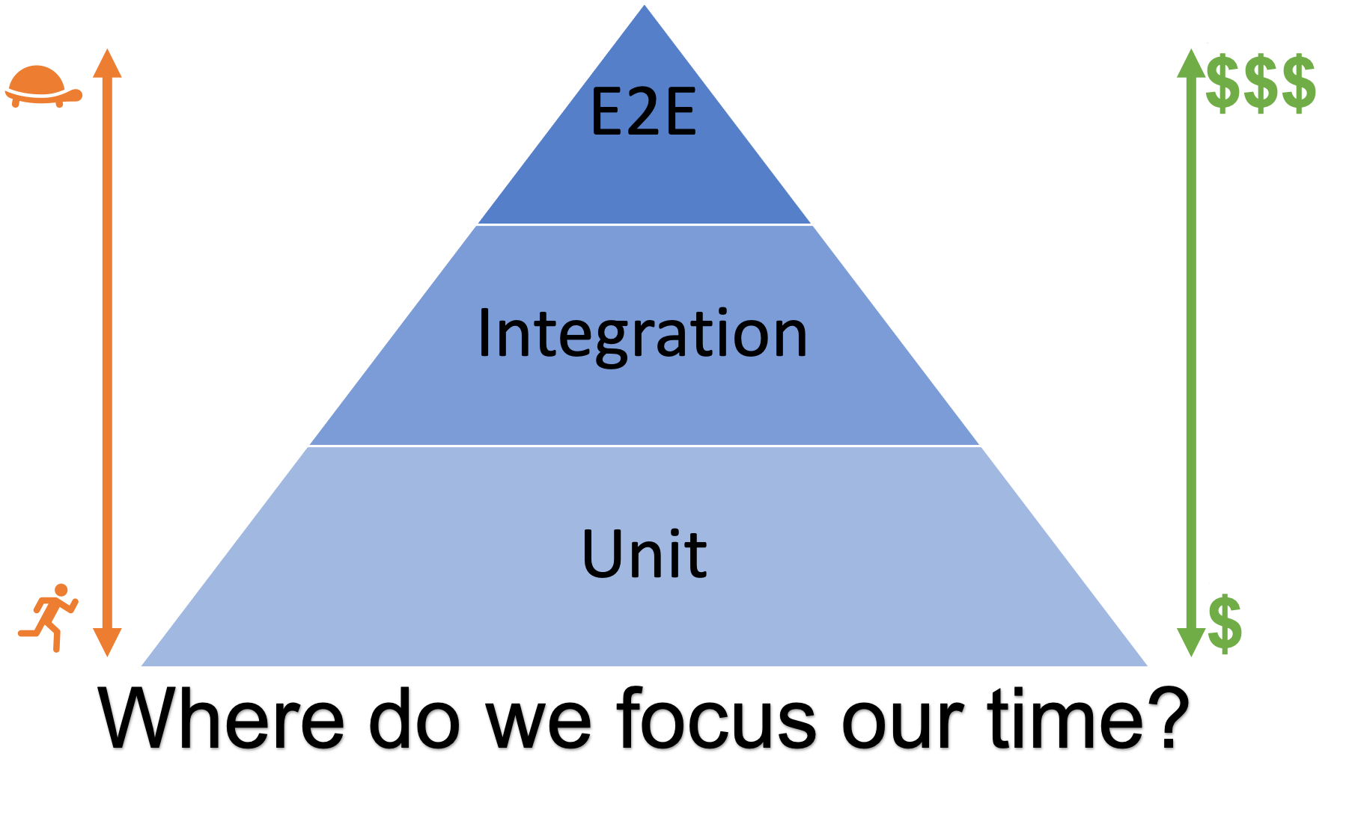
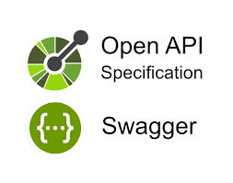
What it is not
Replacement for e2e testing
Magic contract where teams do not need to communicate upfront
OpenAPI schema / specification
Define structure and format of the API vs Contract where, given X, it expects Y
Test against expected value

Slide 8
Why do you use it?
Reduce the need for e2e testing
Reduce/Remove the unexpected “breaking change” to API (breaking of contract)
Provide fast feedback
Provide confidence in deployment
Parallel development

Slide 9
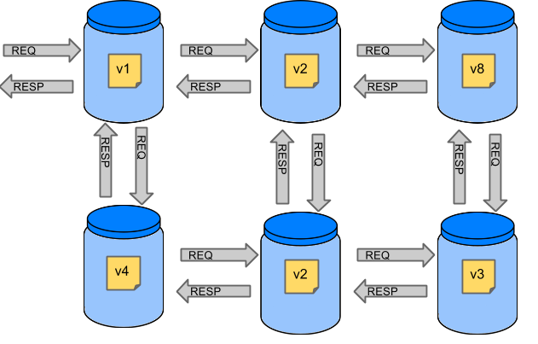
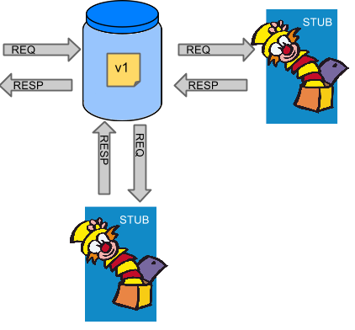
When do you use it?
Source: SCC
Have 2 or more services (team) that need to communicate to each other
Have a more closely collaborated teams
Projects in active development

Slide 10
Consumer Driven Contract Testing

Slide 11
Consumer Driven Contract Testing
Ability to drive the Provider API design (contract)
Define the expectation
Provider takes the contract, and run against the contract (across Consumers) to ensure it meets the requirement of everyone
When?
Knowing who are the consumers
Good:
Usually better designed/friendly API
Bad:
Each consumer may have quite different expectation of “similar” contract, making it difficult to fulfill everyone needs
Consumer generally come up with the API they _really_ needs for provider to fulfill
Teams still need to talk to each other before coming up with contracts

Slide 12
Pact

Slide 13
Pact
Consumer-first Driven Contract
Generated Contract
Contract defined in JSON
Supports multiple languages
JVM (Java, Scala)
Non JVM (JS, Go, Python)
Provider MockServer
Pact Broker
House the contracts and verification results
Support Plugins
Notes:
https://github.com/pact-foundation/pact-plugins

Slide 14
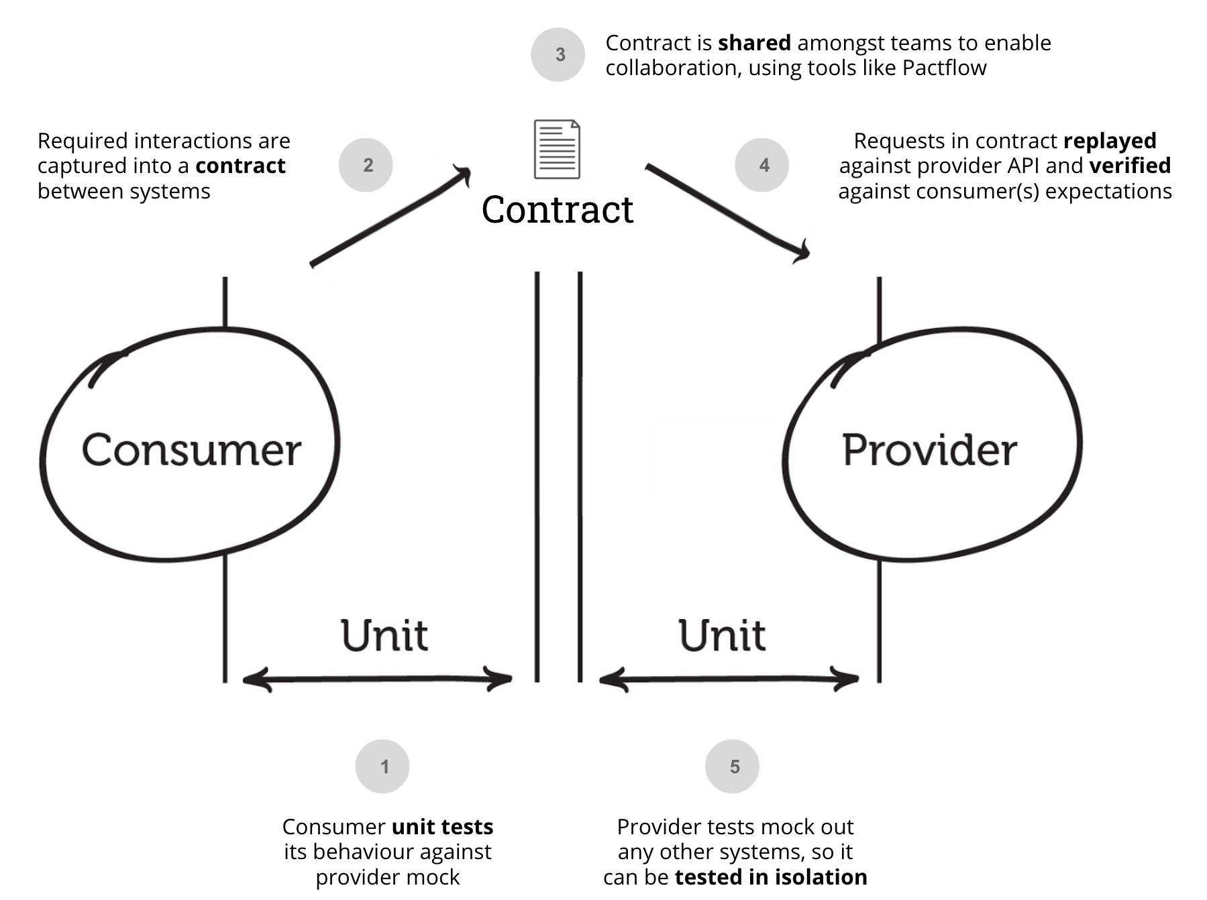
How it works
Source: Pact Docs

Slide 15
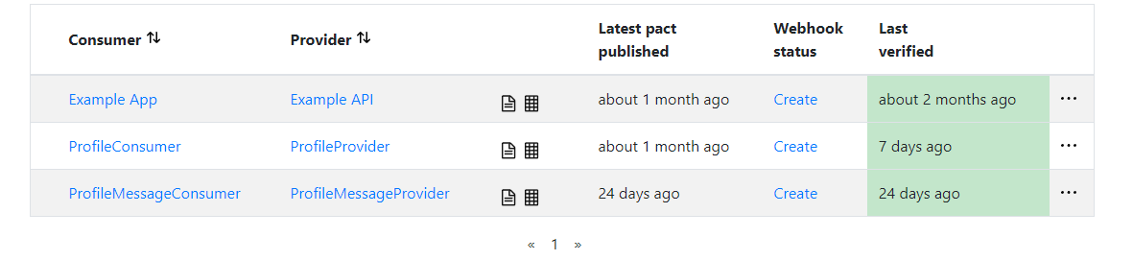
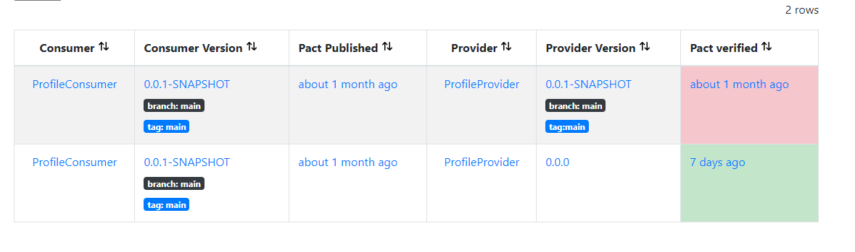
Pact Broker

Slide 16
Scenario
Provider add new field
No impact to Consumer
Unless Consumer requires it as well, then have to update the contract
Provider remove existing field
Contract will fail if Consumer relies on this field
Provider change datatype of existing field
Contract will fail if Consumer relies on this field

Slide 17
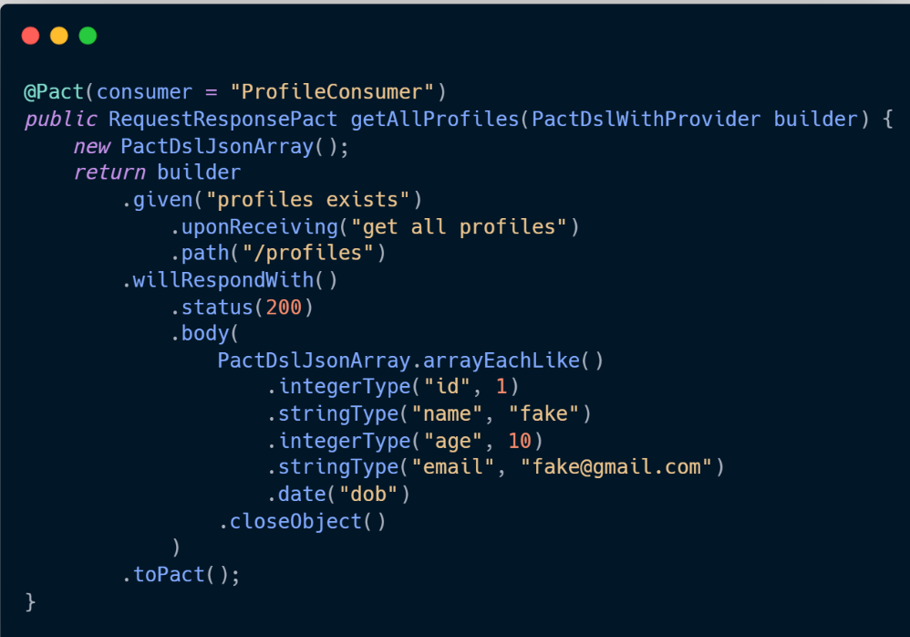
What does a contract look like
Request
url, method, headers, query params, body
Response
status, headers, body
Body
pre-defined type (ipAddress, hexValue, uuid, timestamp)
Generated to JSON
Will see sample during demo

Slide 18
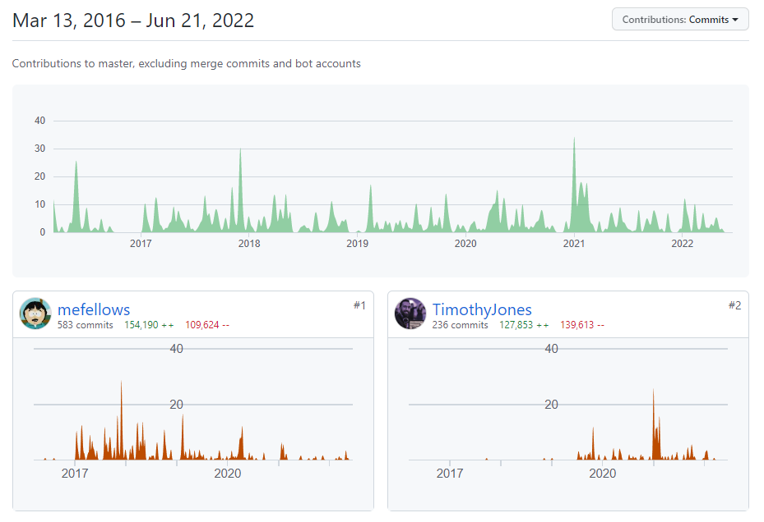
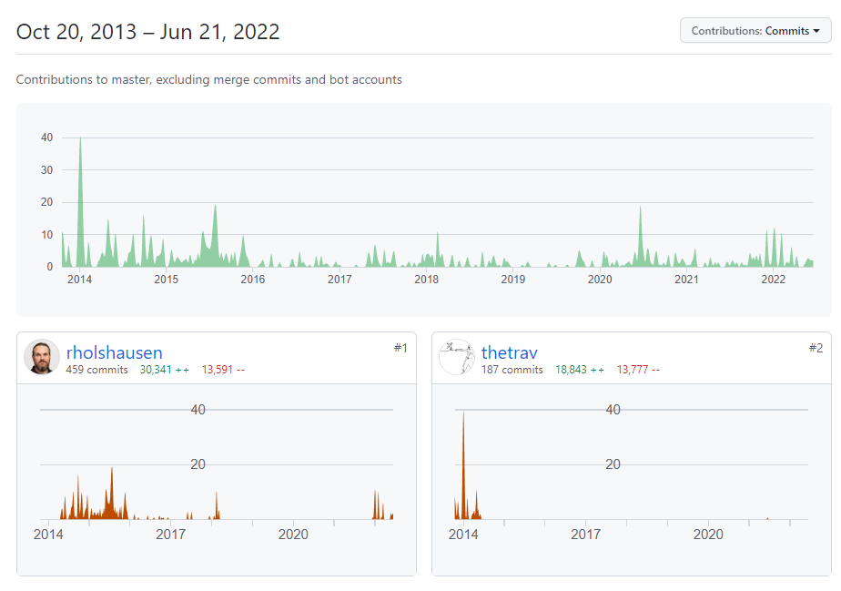
Active
Pact-JS
Pact-JVM

Slide 19
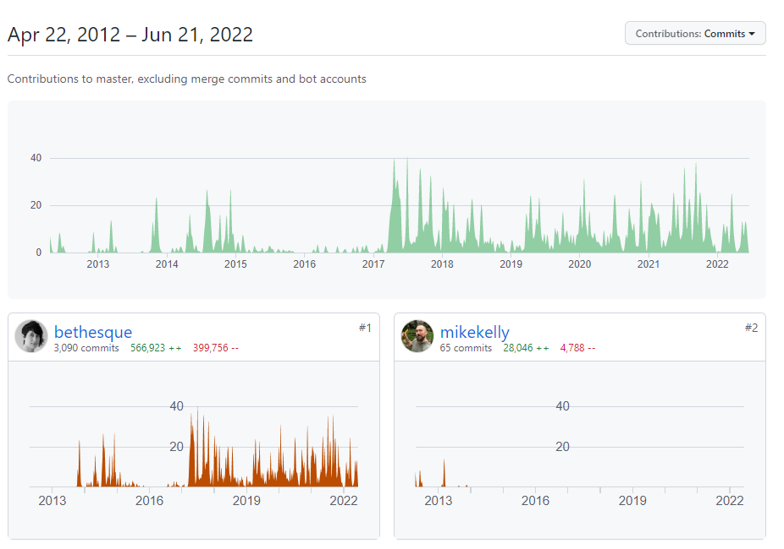
Active
Pact-Broker

Slide 20
DEMO

Slide 21
Provider Driven Contract Testing

Slide 22
Provider Driven Contract Testing
Provides all the different API expectation in the contract
Consumer takes the contract, and determine which are the useful one to use
When?
Unsure who are the consumer
Bad:
Produce less friendly API

Slide 23
Spring Cloud Contract

Slide 24
Spring Cloud Contract
Provider-first Driven Contract
Support Consumer Driven too
Handwritten contract
Contract defined in YAML, Groovy, Java, Kotlin
Supports multiple languages
JVM (Java, Scala)
Non JVM (Docker-based option - more involved setup)
Supports integration with Pact via additional dependency
spring-cloud-contract-pact
Integrates with Wiremock as the HTTP server stub (In-memory HTTP Server)
Provides stubbed response to matching request
Integrates seamlessly with Spring Boot projects

Slide 25
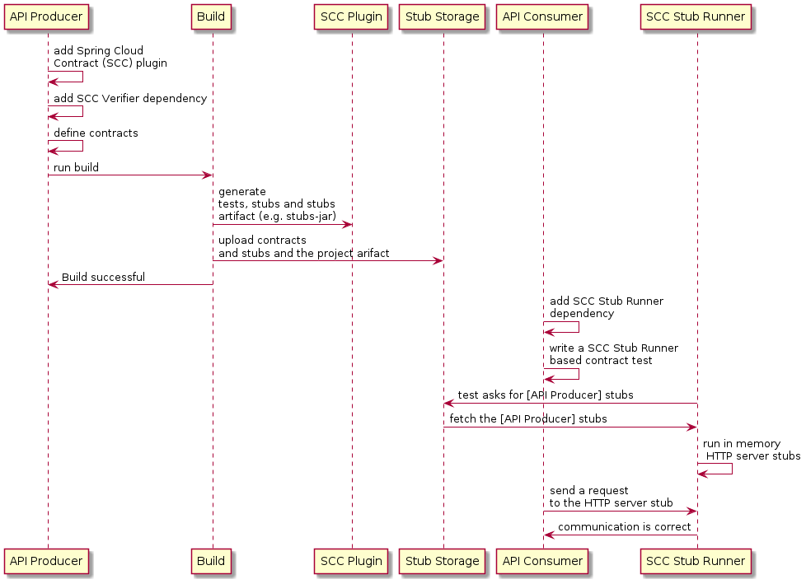
How it works
Source: SCC Docs

Slide 26
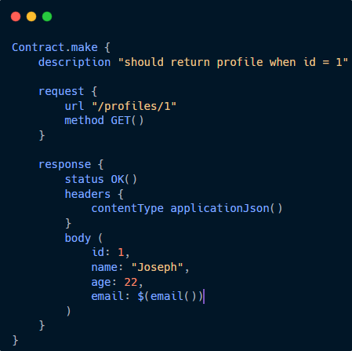
What does a contract look like
Request
url, method, headers, query params, cookies, body, multipart
Response
status, headers, body
Body
supports optional
pre-defined regex (email, alphaNumeric, isoDateTime)

Slide 27
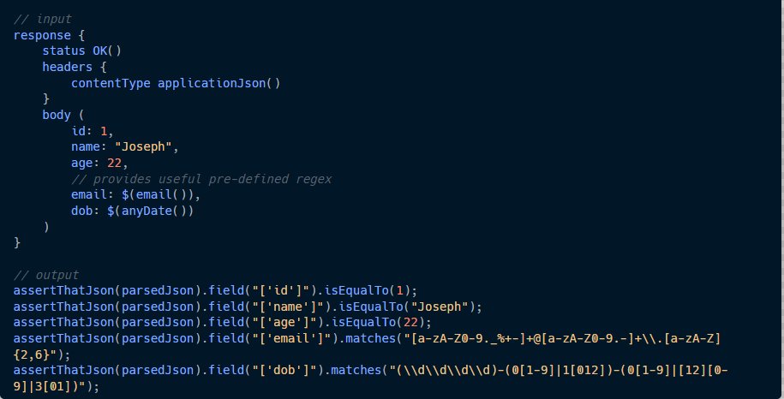

Slide 28
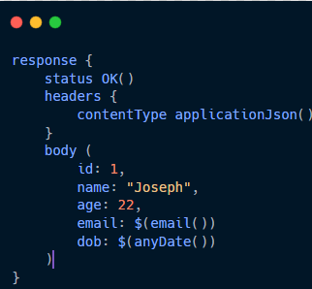
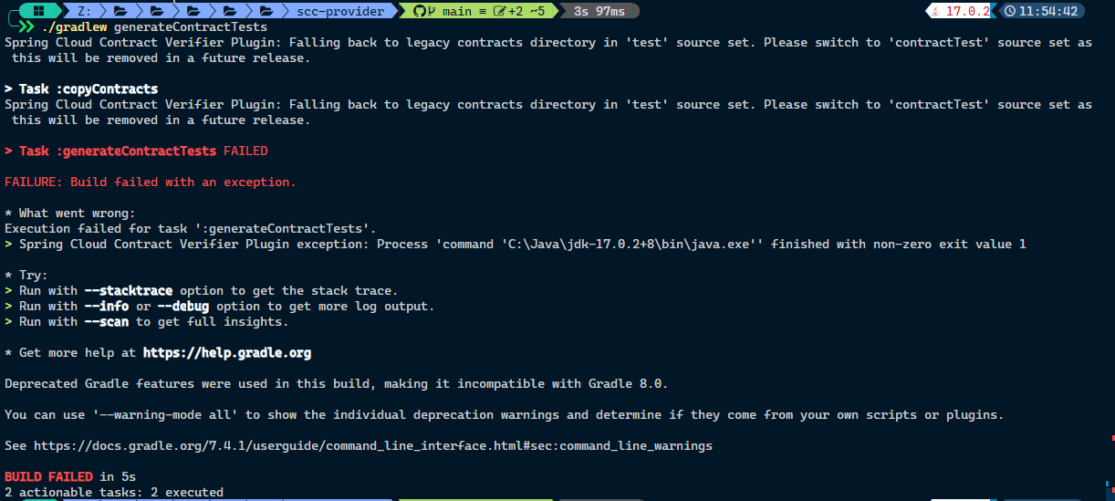
Non-helpful error
Build fails without helpful error message
Anyone can spot it?
Notes:
This happens when you forget a comma on email

Slide 29
DEMO

Slide 30
Comparison Table

Slide 31
Summary
 | Pact | SCC
First Class Citizen | Consumer-first | Provider-first
Contract Language Support | JSON | YAML, Groovy, Java, Kotlin
Language Support | Java, Scala, JS, Python, Go and more | Java, any*
Contract is | Generated | Written
Stores Contract in | Pact Broker, Git Repository, Local Folder | Git Repository, Artifact Repository, Local m2
Verify | HTTP, Messaging | HTTP, Messaging**
*Docker Based **Supports Camel, SCS, AMQP, JMS, Kafka, Integration

Slide 32
Further Exploration
Authentication / Authorization in Contract Testing
Recommended testing outside of Contract
Multipart Request
Testing with query params
Integration with CI
Versioning
Possible to use both SCC and Pact together
Consumer have to option to generate contract using Pact and submit to Broker
Provider is able to consume from Pact, and verify the contract
Notes:
https://docs.pact.io/provider/handling_auth

Slide 33
Support
Need the buy-in of different teams
Can’t be half using PDC, half using CDC
A Provider can be a Consumer and vice versa

Slide 34
Alternative?
Postman + newman

Slide 35
Questions?

